Slide 1
MAZE SOLVING BOT
By: 1604-21-735-018,019,020

Slide 2
TABLE OF CONTENTS
1. | INTRODUCTION
2. | COMPONENTS
3. | BLOCK DIAGRAM
4. | CIRCUIT DIAGRAM
5. | RESULTS

Slide 3
Introduction
Modern robotics technologies are focused on developing self navigating autonomous robots to automate our day to day processes. This means that most of the research focuses on improving sensors and algorithms to build flexible and accurate robots. The maze solving robots also known as micro mouse is designed to find a path without any assistance or help. As a type of autonomous robot, it has to decode the path on its own to solve the maze successfully. So its logic is quite different from the line following robot which follows a predetermined route. These types of autonomous mobile robots can be used in a wide variety of applications such as material handling, warehousing management, pipe inspection and bomb disposal

Slide 4
2
COMPONENTS

Slide 5
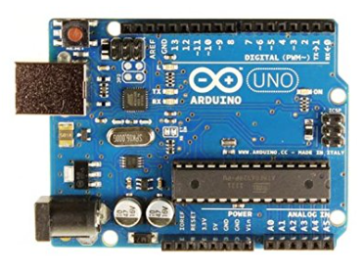
ARDUINO UNO
The Arduino Uno is a microcontroller board designed for beginners and hobbyists to get started with electronics and coding. It's an open-source platform, meaning both the hardware and software are readily available and modifiable.
ATmega328P microcontroller
14 digital input/output pins
6 analog input pins
USB connection
Power jack:
Reset button
ICSP header

Slide 6
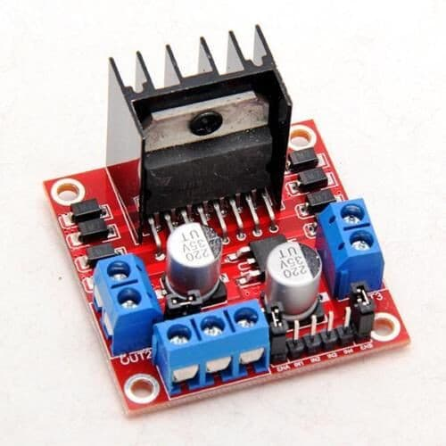
MOTOR DRIVER(L298N)
The L298N is a dual H-bridge motor driver, meaning it can control the speed and direction of two DC motors simultaneously. It's commonly used in robotics, Arduino projects, and other applications where controlling DC motors is essential.
Controls the direction of each motor by switching the polarity of the voltage applied to it. This is achieved through the H-bridge configuration within the chip.
Controls the speed of each motor using Pulse Width Modulation (PWM). By rapidly switching the motor on and off, the average power delivered varies, effectively controlling the speed.

Slide 7
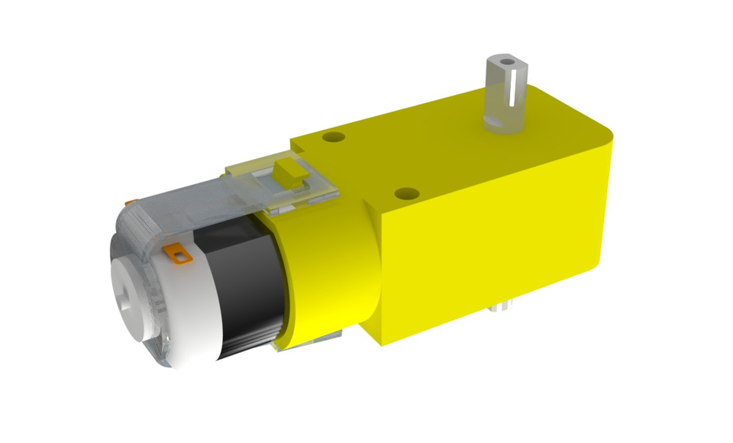
TT MOTORS
A TT motor is a small, inexpensive DC motor combined with a gearbox. This gearbox reduces the motor's speed significantly but increases its torque (turning force), making it ideal for applications like driving robots, manipulating objects, or powering small mechanisms. Often used in beginner projects for its simplicity, affordability, and ease of use, although it lacks advanced features like speed control or feedback.

Slide 8
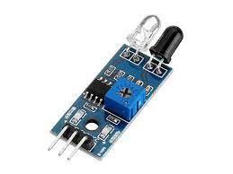
INFRARED SENSOR (IR)
An IR sensor, or infrared sensor, is an electronic device that detects infrared radiation, an invisible form of heat emitted by all objects. It operates by converting this radiation into electrical signals, enabling detection of motion, presence, or even temperature depending on the sensor type.
Two main types exist:
Active IR sensors: Emit their own infrared beam and detect its reflection, measuring distance or proximity precisely.
Passive IR sensors (PIR): Only detect naturally emitted infrared radiation, typically used for basic motion detection in alarms, door openers, and similar applications.

Slide 9
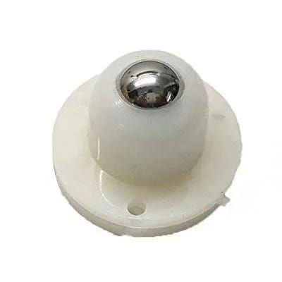
CASTER BALL
A caster ball wheel, featuring a spherical ball encased in a mounting assembly, facilitates effortless omnidirectional movement. Utilized in furniture, carts, and robotics, its design enables smooth rolling on diverse surfaces, making it invaluable for applications necessitating precise steering and maneuverability in constrained spaces. The wheel's construction typically incorporates durable materials like steel or nylon, ensuring longevity and reliability. Available in various sizes and load capacities, caster ball wheels accommodate diverse needs across industries, enhancing efficiency in tasks ranging from office chairs to industrial equipment, where agile transportation and versatility are paramount.

Slide 10
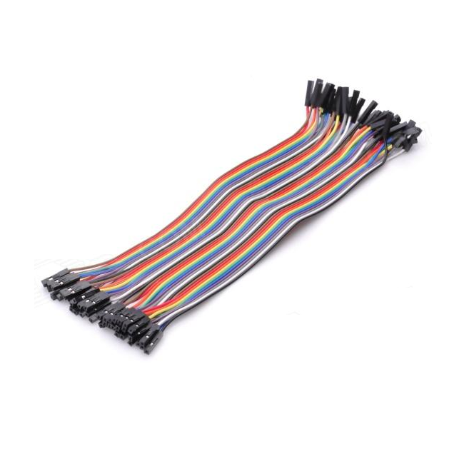
JUMPERS WIRES
Jumper wires are essential components in electronics and prototyping, consisting of insulated wires with connectors at each end. They facilitate the temporary connection of electronic components on breadboards, PCBs, or other circuitry. These wires come in various lengths, colors, and connector types, such as male-to-male, female-to-female, and male-to-female. Jumper wires enable easy experimentation, troubleshooting, and rapid prototyping by allowing quick adjustments or connections between different components without soldering. They play a crucial role in circuit design, education, and hobbyist projects, providing a flexible and convenient solution for establishing electrical connections in a wide range of electronic applications.

Slide 11
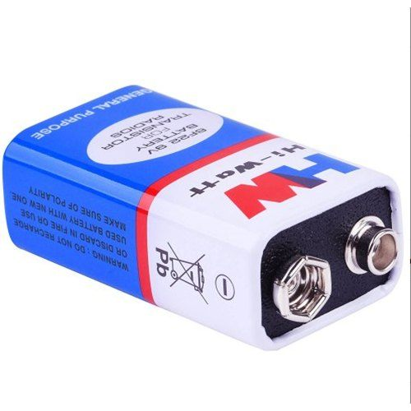
BATTERIES (9v)
9V batteries are compact power sources commonly used in small electronic devices like smoke detectors, remote controls, and guitar pedals. With a rectangular shape and terminal connectors, they provide 9 volts of direct current (DC) power. Typically composed of six cylindrical cells, they offer a balance between portability and longevity. While not as energy-dense as larger batteries, their convenient size makes them suitable for applications requiring compactness. They're easily replaceable and widely available, making them a popular choice for powering low to medium-drain devices where a steady voltage supply is essential, albeit with limited capacity compared to larger battery types.

Slide 12
3
BLOCK DIAGRAM

Slide 13
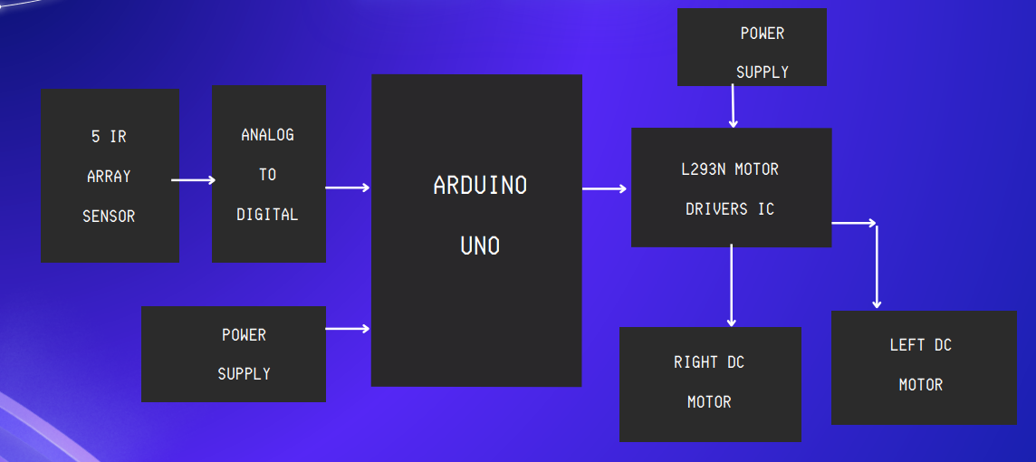

Slide 14
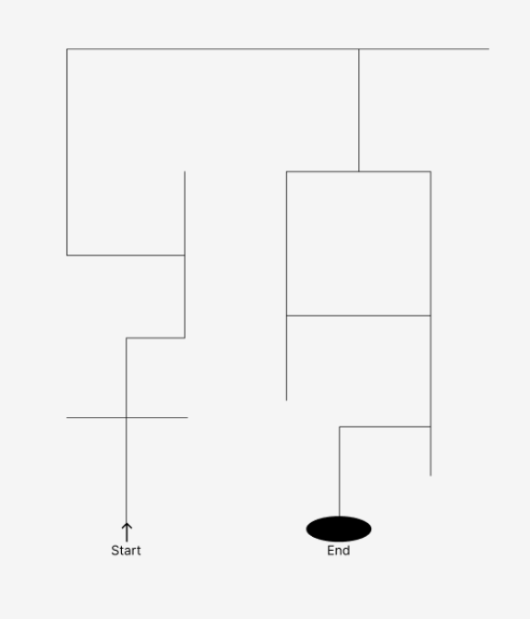
MAP

Slide 15
4
CIRCUIT DIAGRAM

Slide 16
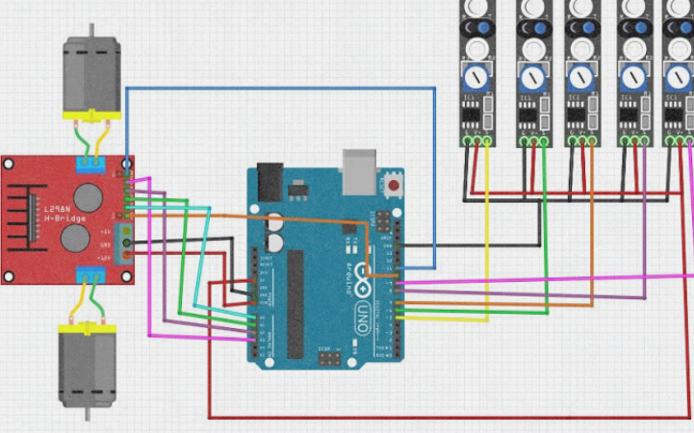

Slide 17
6
RESULT

Slide 18
Maze following robots have ability to track a given path autonomously using feedback mechanisms. The path is usually a black line on a white surface or a white line on a black surface. Today, line following robots are used in medical, industrial and automotive industries.

Slide 19
Thank you!

